Slide 1
IBM Applied Data Science Capstone
Segmenting And Clustering Localities In Mumbai For a Potential Residential Buyer
By: Devbrat Mahapatra

Slide 2
Business Understanding
A client is planning to buy a residential property in Mumbai, India. The client wishes to explore the different areas of Mumbai before buying a residential property. This project will aid in exploring the area as well as show the average price/sqft in the particular area. Clusters of similar localities will also be shown to the client.
The Location: Mumbai is the dream city of India. It houses the film industry and is also the financial hub of India. As a result, every year people shift to Mumbai from various parts of India and this project will cater to many clients.
Foursquare API: This project would use Four-square API as its prime data gathering source as it has a database of millions of places, especially their places API which provides the ability to perform location search, location sharing and details about a business.
Work Flow: Using credentials of Foursquare API features of near-by places of the neighborhoods would be mined. Due to http request limitations the number of places per neighborhood parameter would reasonably be set to 100 and the radius parameter would be set to 500.
Clustering Approach: To compare the similarities of neighborhoods or areas, we decided to explore neighborhoods, segment them, and group them into clusters. To be able to do that, we need to cluster data which is a form of unsupervised machine learning.

Slide 3
Data
Data required:
List of localities and their corresponding prices/sqft.
Longitude and latitude coordinates of the localities.
Venue data.
Data required:
https://www.99acres.com/property-rates-and-price-trends-in-mumbai
Tomtom API for acquiring latitudes and longitudes.
Foursquare API for venue data.

Slide 4
Methodology
Data wrangling for proper formatting of the data.
Getting latitude and longitude coordinates using Tomtom API.
Use Foursquare API to get venue data.
Group data by locality and finding the most common venues.
Clusters of localities are made using K-Means.
Building widgets using Ipywidgets.
Building maps using Folium.

Slide 5
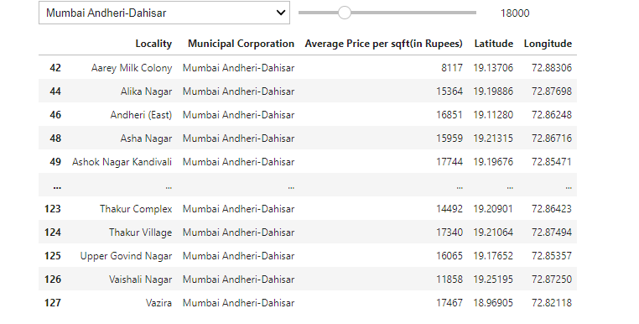
A dashboard created for the client wherein there is a dropdown menu to choose the municipal corporation and a slider for choosing the price.

Slide 6
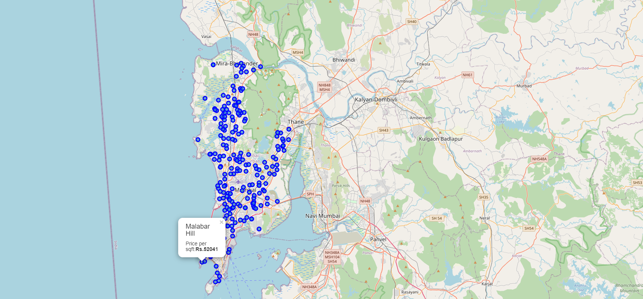
An interactive map created for the client with a popup label which has the following details:
Locality
Price per sqft.

Slide 7
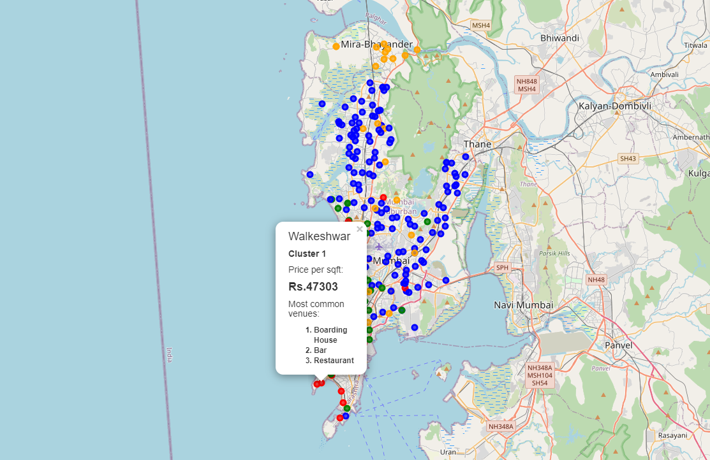
An interactive map created for the client with a popup label which has the following details:
Locality
Cluster
Price per sqft.
Most common venues around

Slide 8
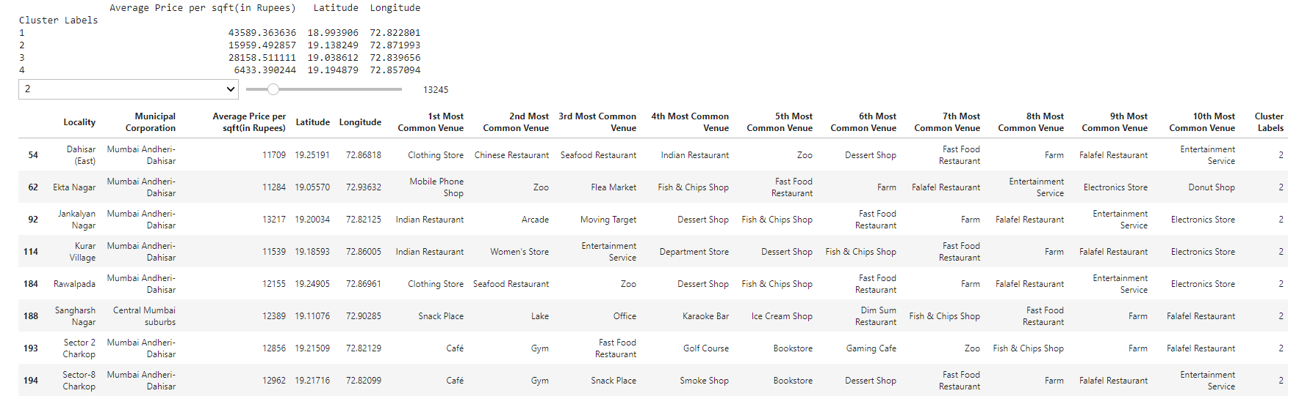
A dashboard with a dropdown menu to choose the cluster label and a slider for choosing the price with the average price per sqft. for every cluster label.

Slide 9
Future improvements
Better location accuracy.
Better cluster model accuracy.
The price per sqft. data is only pertaining to residential apartments in Mumbai and would like to include price for standalone houses.
Data regarding the crime rates in the areas can be included to determine which areas to safer to live.

